Slide 1
Project on Library Management System

Slide 2
Introduction
🔹 Overview This project focuses on building a structured Library Management System using SQL to efficiently manage and organize library data.
🔹 Objective
To design a relational database for real-world library operations
To manage books, borrowers, and transactions effectively
To extract meaningful insights using SQL queries

Slide 3
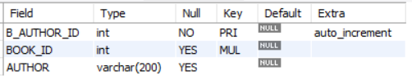
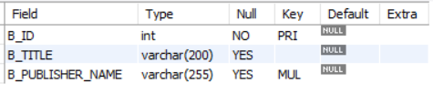


Tables
Authors Table
Book's Table
Publisher's Table
Branch's Table

Slide 4
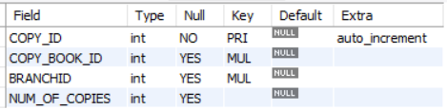
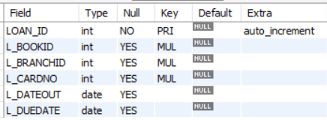
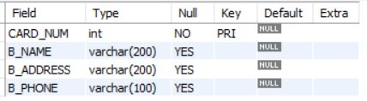
Tables
Copies Table
Loan's Table
Borrower's Table

Slide 5
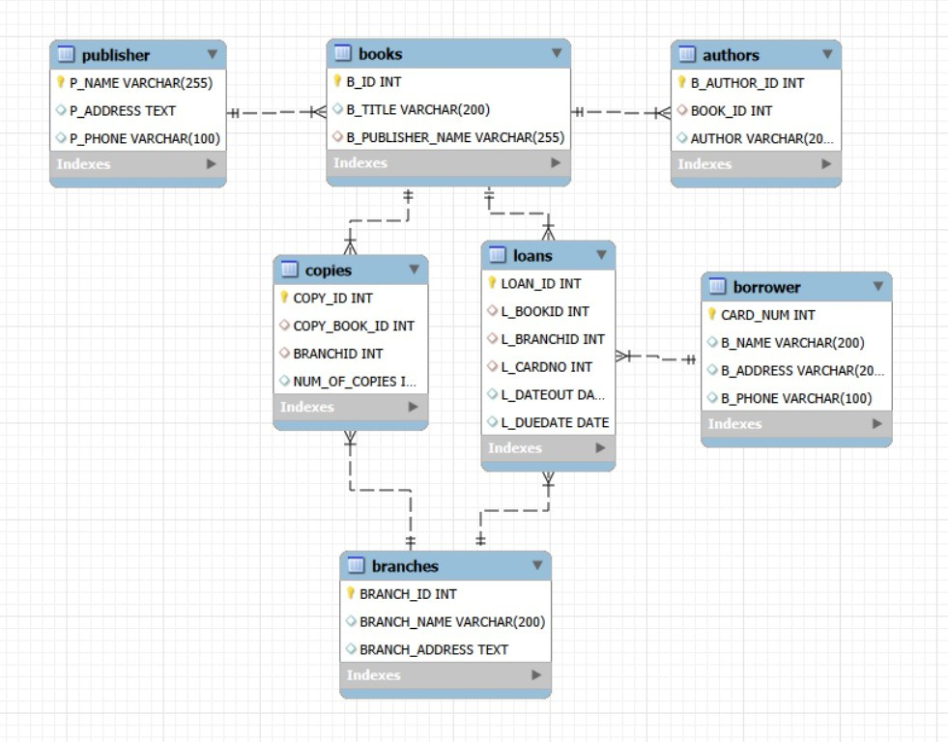
ER Diagram

Slide 6
Problem Statement
Libraries often face challenges in efficiently managing large volumes of data related to books, borrowers, and transactions. Traditional or manual systems make it difficult to track book availability, manage multiple copies across branches, and monitor borrowing activities in real time.

Slide 7
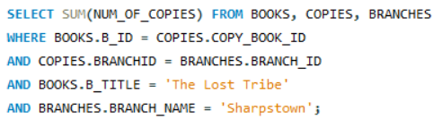

1.How many copies of the book titled "The Lost Tribe" are owned by the library branch whose name is "Sharpstown"?
Query :
Output :

Slide 8
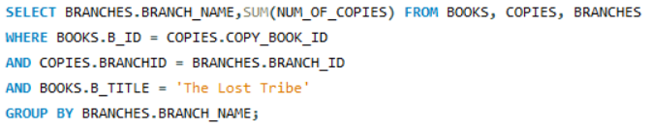
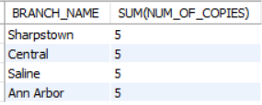
2.How many copies of the book titled "The Lost Tribe" are owned by each library branch?
Query :
Output :

Slide 9
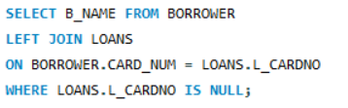

3.Retrieve the names of all borrowers who do not have any books checked out.
Query :
Output :

Slide 10
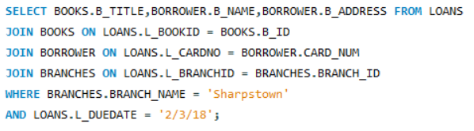
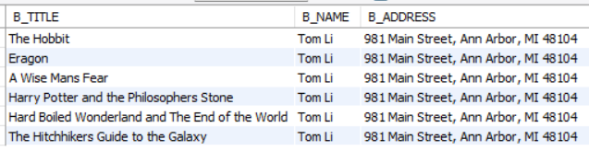
4.For each book that is loaned out from the "Sharpstown" branch and whose DueDate is 2/3/18, retrieve the book title, the borrower's name, and the borrower's address.
Query :
Output :

Slide 11

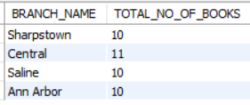
5.For each library branch, retrieve the branch name and the total number of books loaned out from that branch.
Query :
Output :

Slide 12
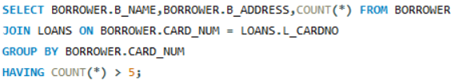
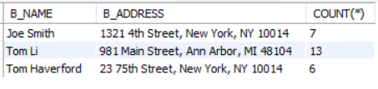
6.Retrieve the names, addresses, and number of books checked out for all borrowers who have more than five books checked out.
Query :
Output :

Slide 13
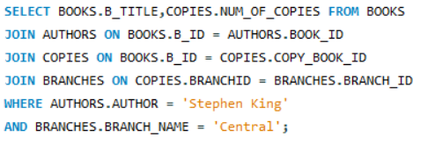

7.For each book authored by "Stephen King", retrieve the title and the number of copies owned by the library branch whose name is "Central".
Query :
Output :

Slide 14
Challenges Faced
Designing The Proper Relationships Between The Tables
Handling Data Integrity And Constraints
Writing The Complex “JOIN” Queries
Understanding Realtime Query Requirements

Slide 15
Key Insights
Identifying Book’s Availability
Analyzed Most Borrow Books And Popular Categories which Is Liked By People
Tracked Active And Inactive Borrower’s
Detecting High Demand Book’s With Limited Copies Across The Branch’s
Helping to Understand Borrowing Pattern’s And Trend’s

Slide 16
Conclusion :
Successfully built a SQL-based Library Management System
Improving The Skills In Data Design And Query Writing
Gained The Practical Experience In Solving Real World Data Problems

Slide 17
Thank You
Presented By:
Mokshagna Jagarlamudi
Shyam Panduru

